Slide 1
Cache Money Solutions
A smart way to manage your business

Slide 2
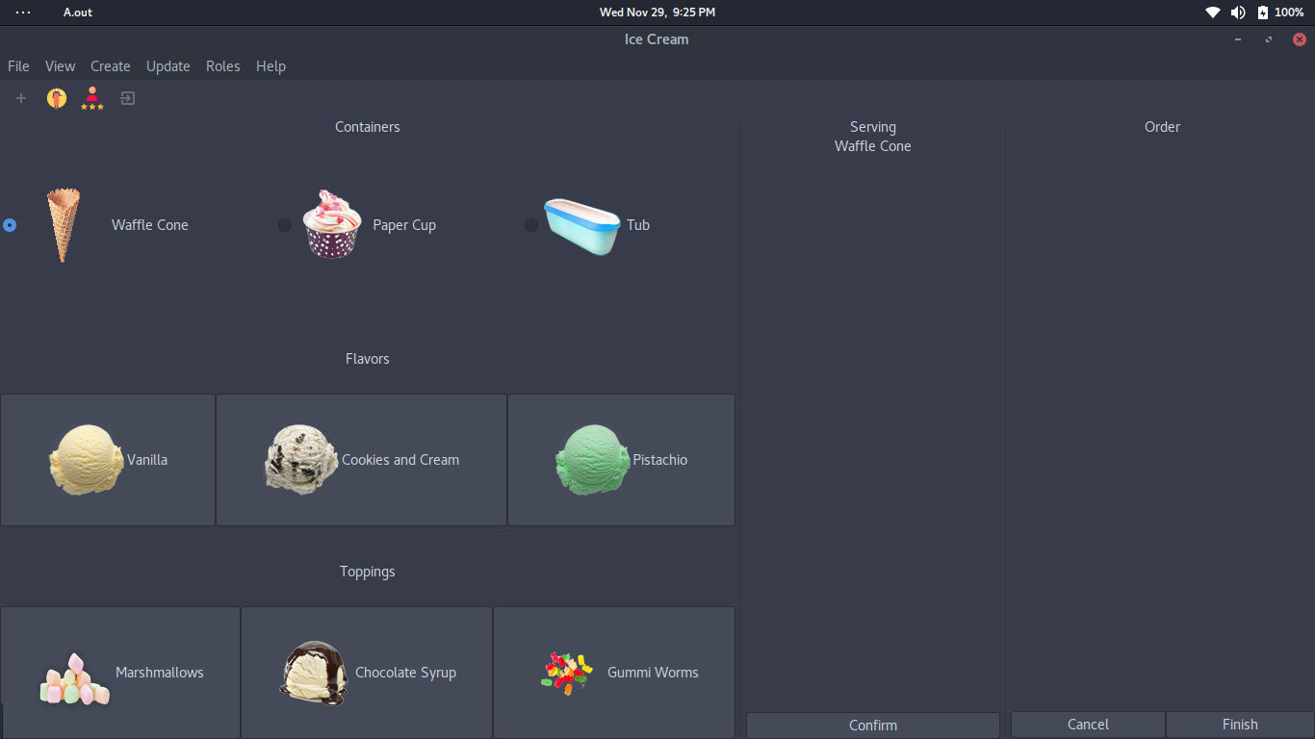
Introducing the our new Ice Cream Application
Easy to use and enriched with features

Slide 3
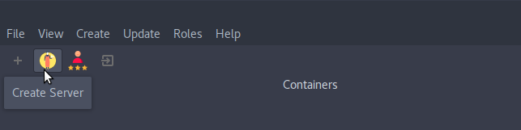
Easy to use file menu and toolbar
A user interface that includes simple menus and helpful tooltips

Slide 4
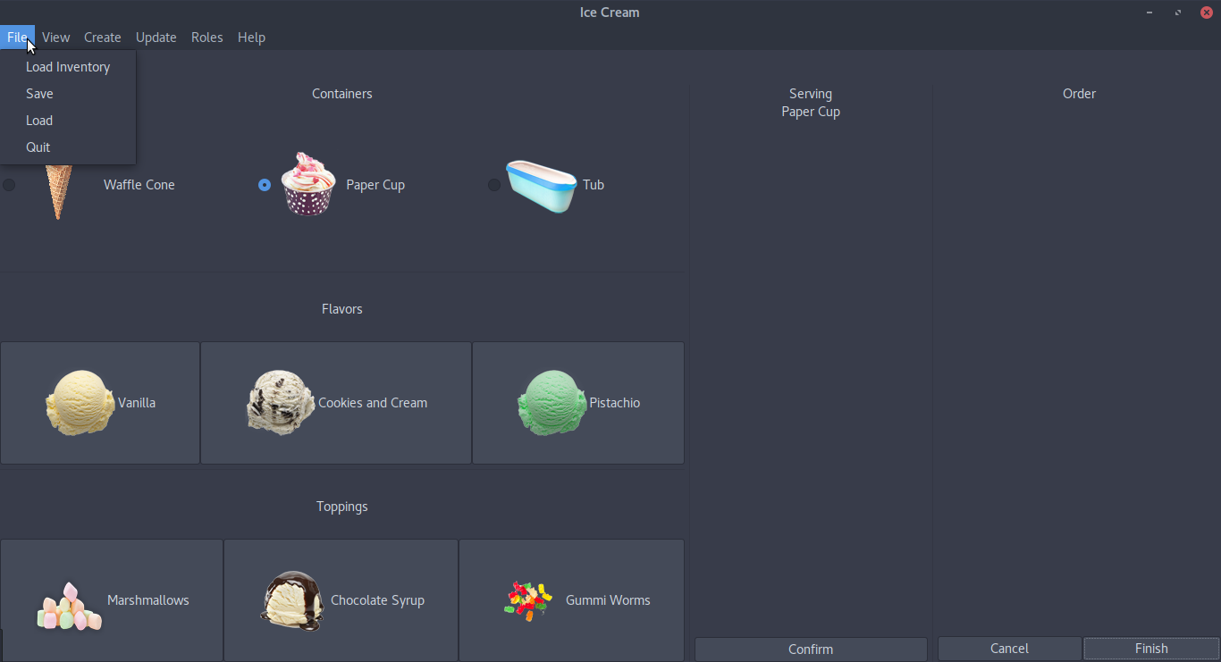
File Menu
Load and save data

Slide 5
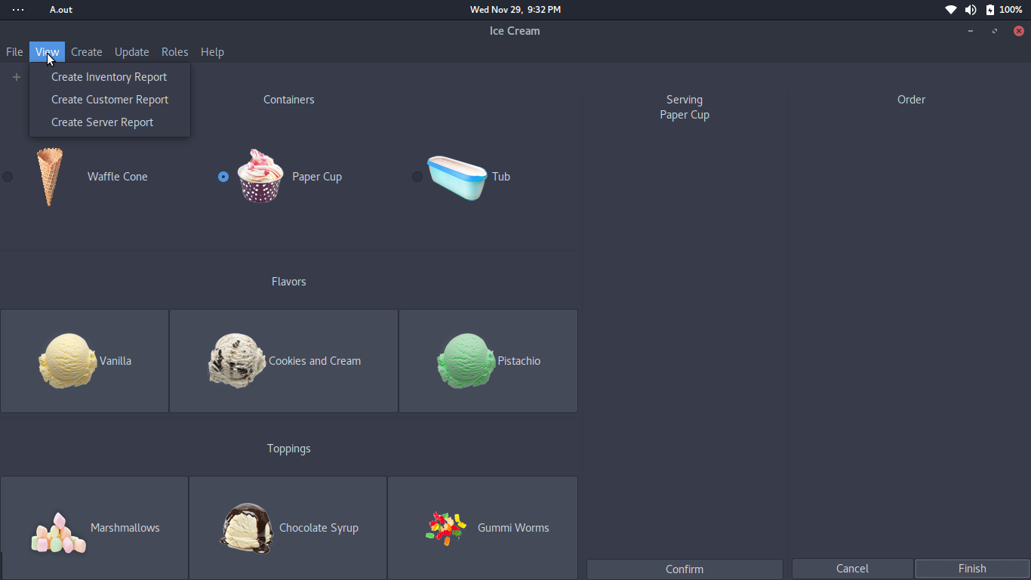
Create and view inventory reports

Slide 6
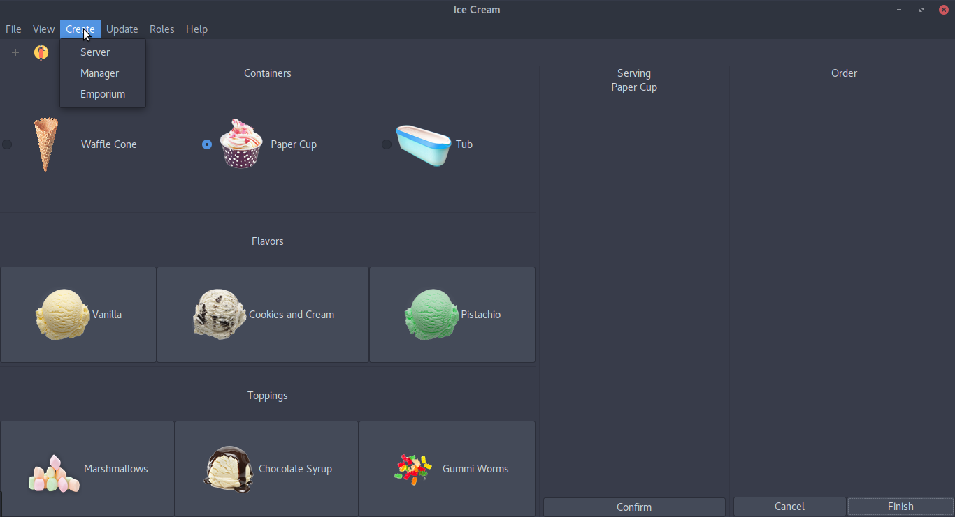
Create..
Add new servers, managers or emporium to your franchise

Slide 7
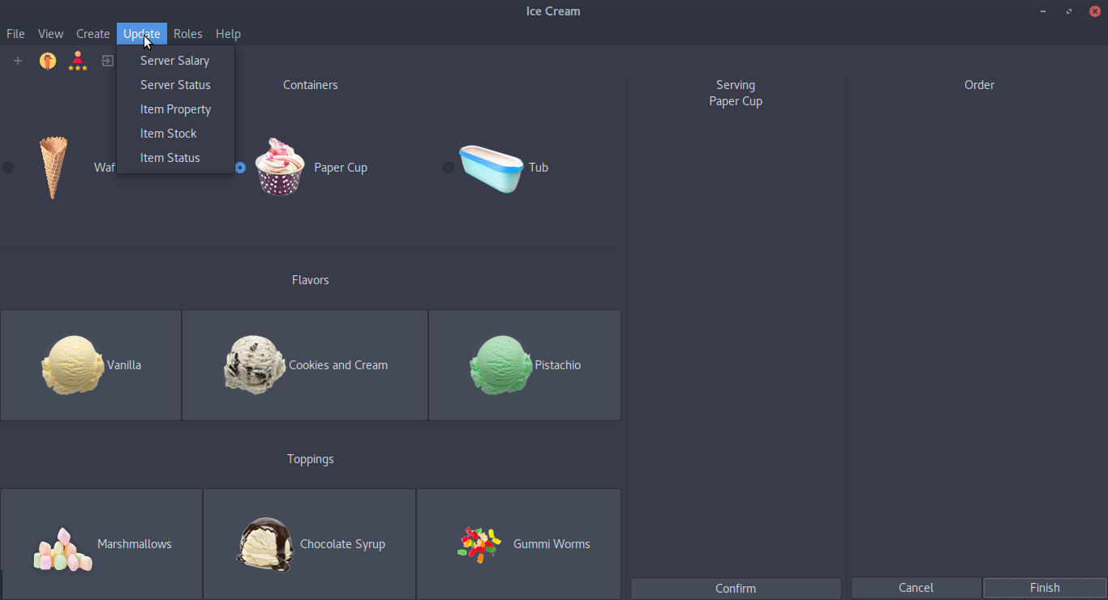
Update
Update your servers salary, item stock and more

Slide 8
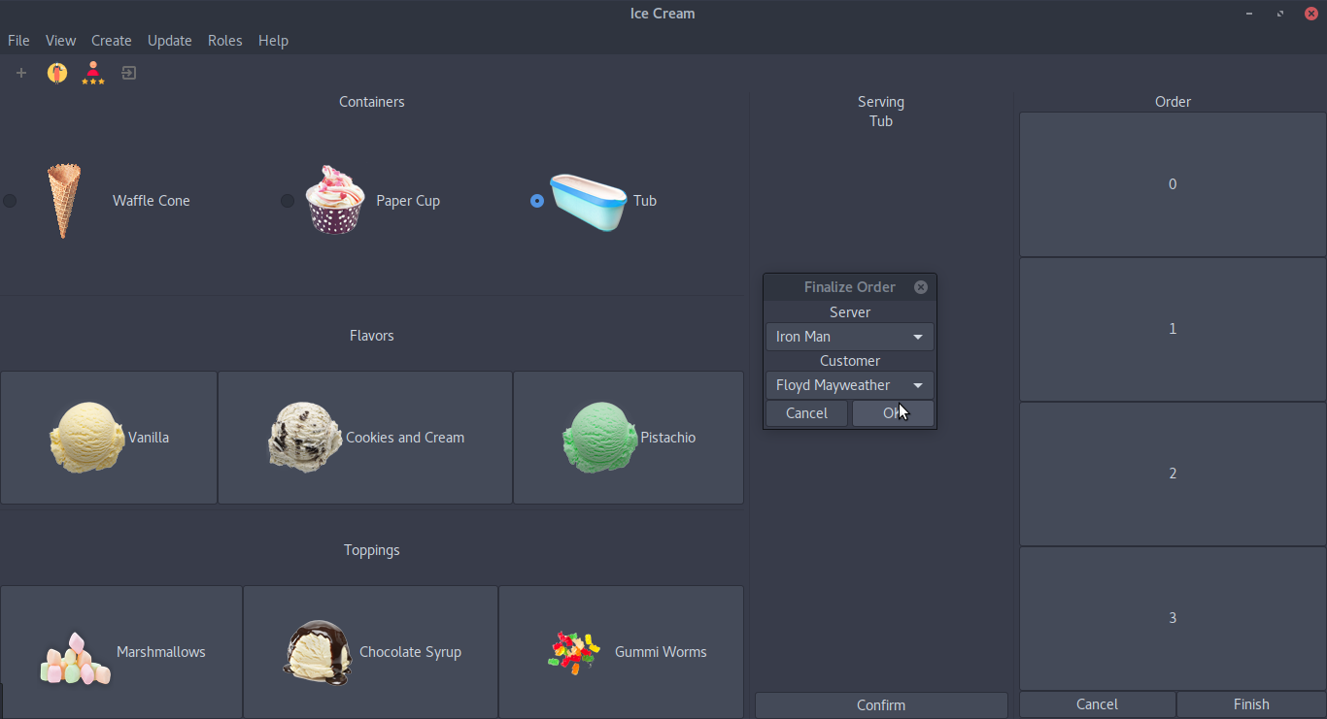
Simple UI for Consumers
Only takes a few clicks for User to complete an order

Slide 9
Thank you
for
choosing
Cache Money Solutions!

